Slide 1

AutoCad 2021
د. وميض تركي محمد

Slide 2
في نهاية هذا الدرس يستطيع الطالب أن يتعرف على:
استخدام المجموعة الاولى من ادوات التصحيح Use the 1st group of editing tools

Slide 3
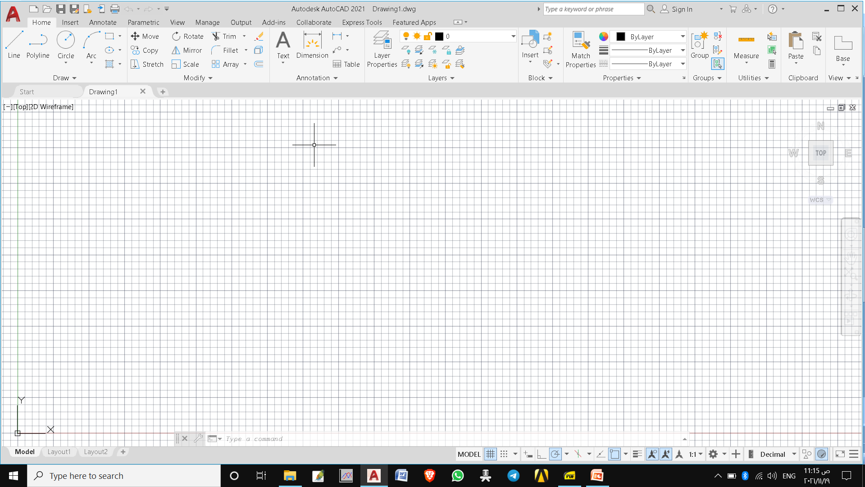
أدوات التصحيح Editing tools
In previous chapters, you have learned to create some simple drawings using the basic drawing tools. However, to create complex drawings, you may need to perform various editing operations. The tools to perform the editing operations are available in the Modify panel of the Home ribbon. You can click the down arrow on this panel to find more editing tools. Using these editing tools, you can modify existing objects or use existing objects to create new or similar objects.
Move - Rotate -Trim - Erase -Copy - Mirror - Fillet
Explode- Stretch – Scale - Array - offset

Slide 4
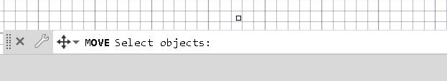
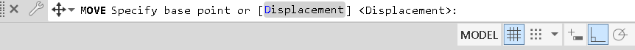
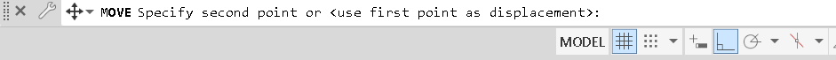
أدوات التصحيح Move Editing tools
The Move tool is used to move a selected object(s) from one location to a new location without changing its orientation. To move objects, you need to select this tool and select the objects from the drawing area. After selecting objects, you need to specify the ‘base point’ and the ‘destination point’.

Slide 5
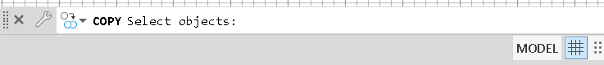
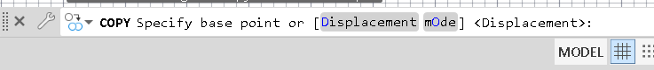
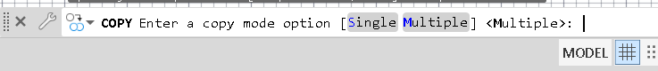
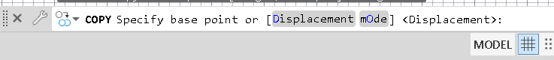
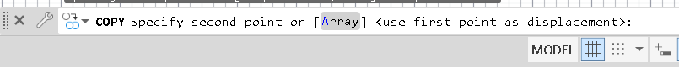
أدوات التصحيح Copy Editing tools
The Copy tool is used to copy objects and place them at a required location. This tool is similar to the Move tool, except that object will remain at its original position and a copy of it will be placed at the new location.
Select object and press enter
Select O and press enter
Select S for single cope and M for multiple copy
Select base point and press enter
Select 2nd point and press enter

Slide 6
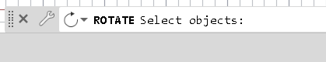
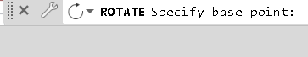
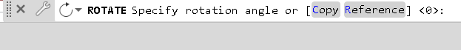
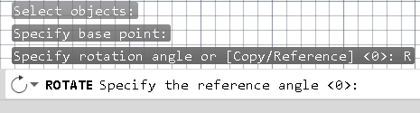
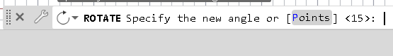
أدوات التصحيح Rotate Editing tools
The Rotate tool is used to rotate an object or a group of objects about a base point. To rotate objects, you need to invoke this tool and select the objects from the drawing window. After selecting objects, you need to specify the ‘base point’ and the angle of rotation. The object(s) will be rotated about the base point.
Select objects and press enter
Select the base point and press enter
Select C to rotate a copy
Select R to rotate about a specific angle
Select the reference angle and press enter
Select the new angle and press enter

Slide 7
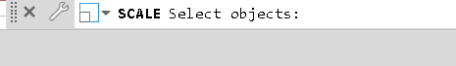
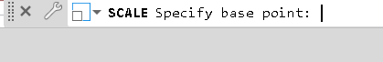

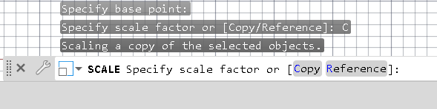
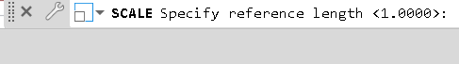
أدوات التصحيح Scale Editing tools
The Scale tool is used to change the size of objects. You can reduce or enlarge the size without changing the shape of an object. To scale objects, you need to invoke this tool and select the objects from the drawing window. After selecting objects, you need to specify the ‘base point’ and the scale factor. The scale factor is the ratio between the original size of the object and the size to be achieved. For example, if you specify the scale factor as 2, the size of the object will be doubled.
Select object and press enter
Select the base point and press enter
Select C to scale a copy of the object then Enter
the scale factor
Select R to scale the selected objects based on a reference length and a specified new length

Slide 8
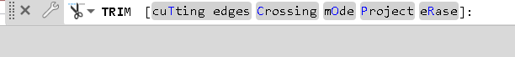
أدوات التصحيح Trim Editing tools
When an object intersects with another object, you can remove its unwanted portion by using the Trim tool. To trim an object, you need to first invoke the Trim tool, and then select the cutting edge (intersecting object) and the portion to be removed. If there are multiple intersection points in a drawing, you can simply select the select all option from the command line; all the objects in the drawing objects will act as ‘cutting edges’.
Select the part that you need to trim

Slide 9
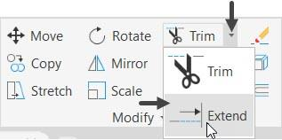
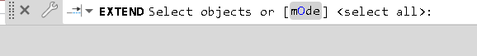
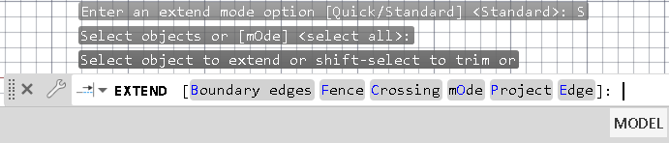
أدوات التصحيح Extend Editing tools
The Extend tool is similar to the Trim tool but its use is opposite of it. This tool is used to extend lines, arcs and other open entities to connect to other objects. To do so, you need to select the boundary up to which you want to extend the objects, and then select the objects to be extended.
Press Enter
Select the edges to extend similar to
the Trim procedure

Slide 10
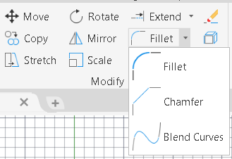

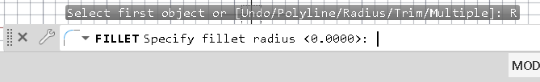
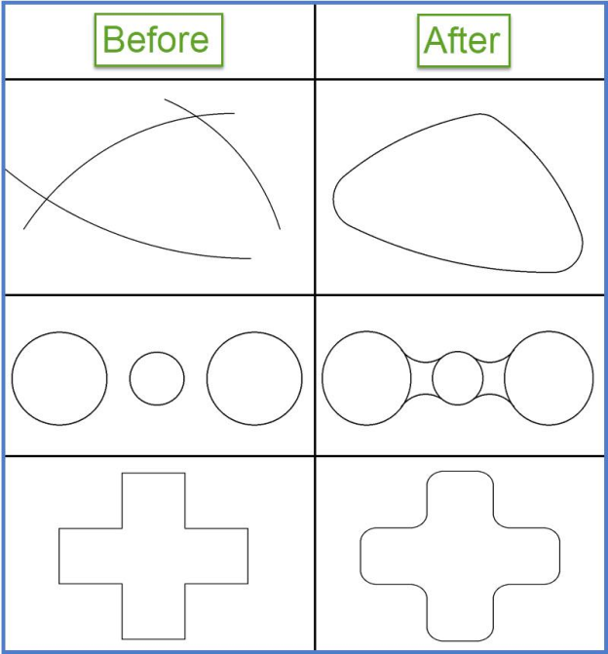
أدوات التصحيح Fillet Editing tools
The Fillet tool is used to convert the sharp corners into round corners. To do so, you need to specify the radius and select the objects to be filleted. The following figure shows some examples of rounding the corners.
Choose R to choose the radius and press enter
Choose M to use fillet multiple times

Slide 11

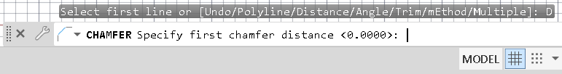
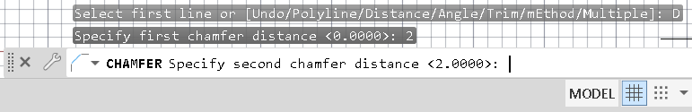
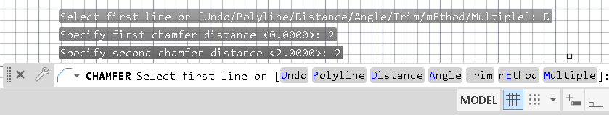
أدوات التصحيح Chamfer Editing tools
The Chamfer tool is used to replace the sharp corners with an angled
line. This tool is similar to the Fillet tool, except that an angled line is placed at the corners instead of rounds.
Select D to enter the distance
Specify the 1st distance and press Enter
Specify the 2nd distance and press Enter
Select the angles as same as we did in fillet

Slide 12
أدوات التصحيح Chamfer Editing tools
The Chamfer tool is used to replace the sharp corners with an angled
line. This tool is similar to the Fillet tool, except that an angled line is placed at the corners instead of rounds.
Select D to enter the distance
Specify the 1st distance and press Enter
Specify the 2nd distance and press Enter
Select the angles as same as we did in fillet

Slide 13
الدرس القادم ... AutoCAD 2021
في الدرس القادم ... سنكمل الجزء الثاني من أدوات التصحيح... بإذن الله
شكراً جزيلا

